Slide 1
Business Case Solving
Nikita Joshi
Linkedin :-https://www.linkedin.com/in/nikita-joshi-62676981/
Github:-https://github.com/NIKI758
Gmail:-joshink75@gmail.com

Slide 2
Tables to be Downloaded
Customers
Suppliers
Employees
Products
Shippers
Orders
Order_Details

Slide 3
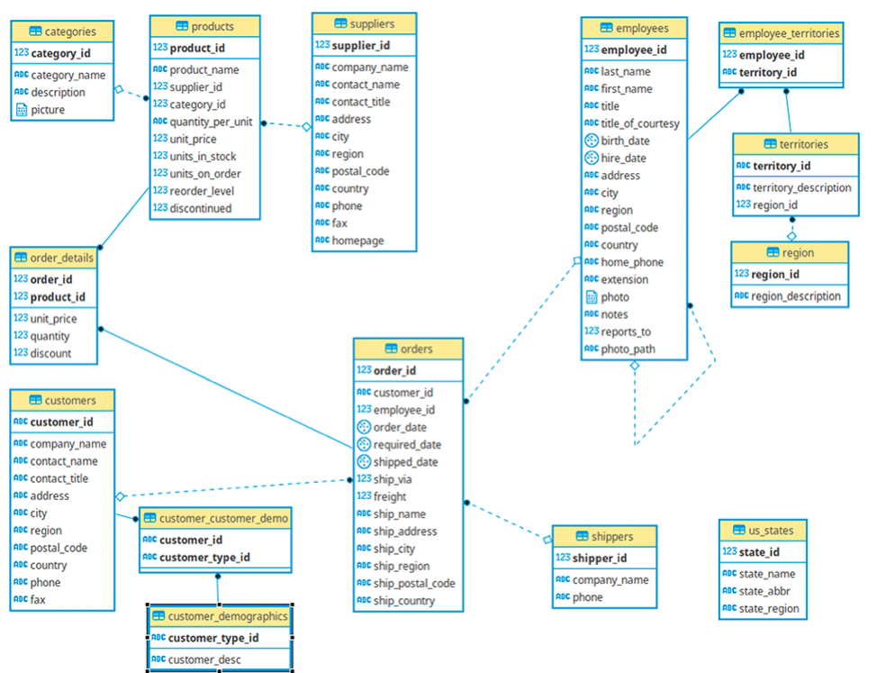
Schema

Slide 4
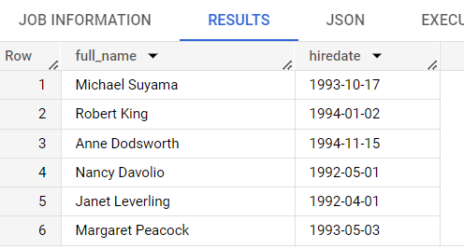
Ques. Fetch the full name and hiring date of all Employees who work as Sales Representatives.
select concat(firstname," ",lastname)as full_name,hiredate from `cochin_traders.employees` where title="Sales Representative"

Slide 5
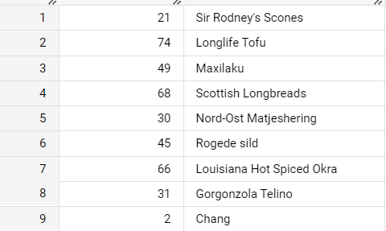
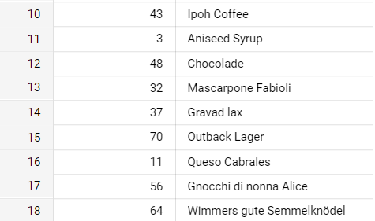
Ques. Which of the products in our inventory need to be reordered?
Note: For now, just use the fields UnitsInStock and ReorderLevel, where UnitsInStock is less than the ReorderLevel, ignoring the fields UnitsOnOrder and Discontinued.
select productid,productname from `cochin_traders.products` where unitsinstock<reorderlevel

Slide 6
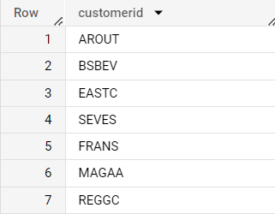
Ques. Find and display the details of customers who have placed more than 5 orders.
select c.customerid,c.contactname
from `cochin_traders.orders` o
inner join `cochin_traders.customers` c
on o.customerid=c.customerid
group by c.customerid,c.contactname
having count(distinct o.orderid)>5
select customerid
from `cochin_traders.customers`
where customerid in(select customerid
from `cochin_traders.orders` group by customerid having count(distinct orderid)>5)

Slide 7
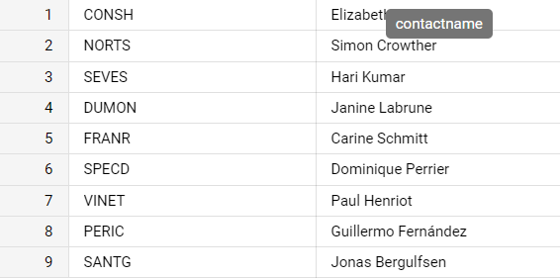
Ques: An employee of ours (Margaret Peacock, EmployeeID 4) has the record of completing most orders. However, there are some customers who've never placed an order with her. Show such customers.
select distinct c.customerid,c.contactname
from `cochin_traders.customers` c
inner join `cochin_traders.orders` o
on c.customerid=o.customerid
where o.customerid not in
(select customerid from `cochin_traders.orders` where employeeid=4)

Slide 8
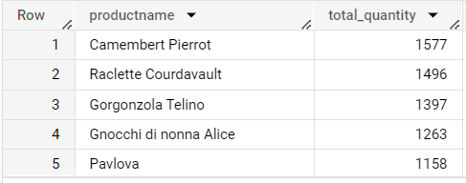
Ques. Retrieve the top 5 best-selling products on the basis of the quantity ordered.
SELECT p.productname,sum(od.quantity) as total_quantity
from
`cochin_traders.orders_details` od
inner join
`cochin_traders.products` p
on od.productid=p.productid
group by p.productname
order by total_quantity desc
limit 5

Slide 9
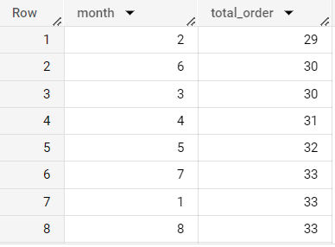
Ques. Analyze the monthly order count for the year 1997.
select extract(month from orderdate) as month,count(orderid) as total_order
from `cochin_traders.orders` where extract(year from orderdate)=1997
group by month order by total_order

Slide 10
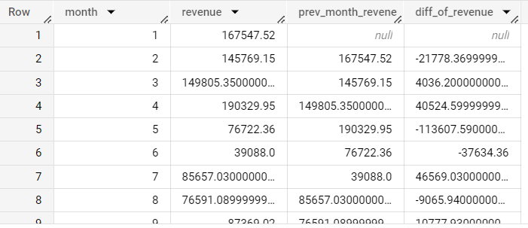
Ques: Calculate the difference in sales revenue for each month compared to the previous month.
with monthyr as(
select extract(month from orderdate)as month,sum(unitprice*quantity) as revenue
from `cochin_traders.orders_details` od
inner join `cochin_traders.orders` o on
od.orderid=o.orderid
group by month)
select month,revenue,lag(revenue,1) over(order by month) as prev_month_revene,
revenue-lag(revenue,1) over(order by month) as diff_of_revenue
from monthyr order by month

Slide 11
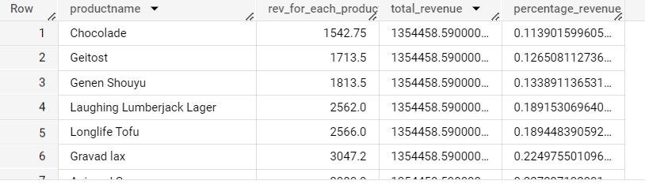
Ques: Calculate the percentage of total sales revenue for each product.
with cte as(
select *,sum(rev_for_each_products) over() as total_revenue from(
select p.productname,sum(od.quantity*od.unitprice) as rev_for_each_products
from
`cochin_traders.products` p
inner join
`cochin_traders.orders_details` od
on p.productid=od.productid
group by p.productname))
select *,(rev_for_each_products/total_revenue)*100 as percentage_revenue
from cte order by percentage_revenue

